Slide 1

Project By:-
Ayush Gupta (199303177)
Kriti Vaid (199303178)
Kushagra Sikka (199303230)
Mentored By:-
Dr. Shivani Gupta

Slide 2
Stock Market Prediction Using Machine Learning Techniques

Slide 3

Statement of Problem
Our objective is the understand the basics of Machine learning . And determine the most reasonable method of predicting the market and find the best way to find the future stock value with the least error possible
The Stock Market prediction task is interesting as well as divides researchers and academics into two groups those who believe that we can devise mechanisms to predict the market and those who believe that the market is efficient and whenever new information comes up the market absorbs it by correcting itself, thus there is no space for prediction.

Slide 4
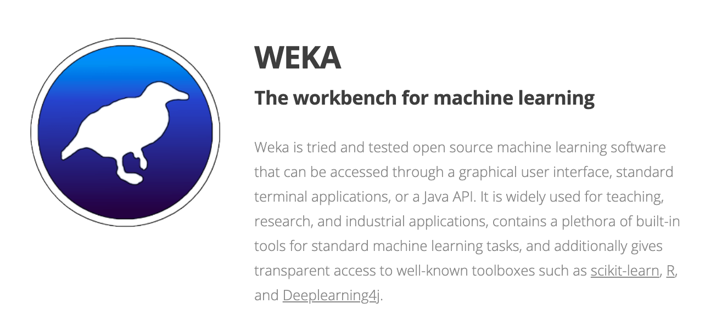
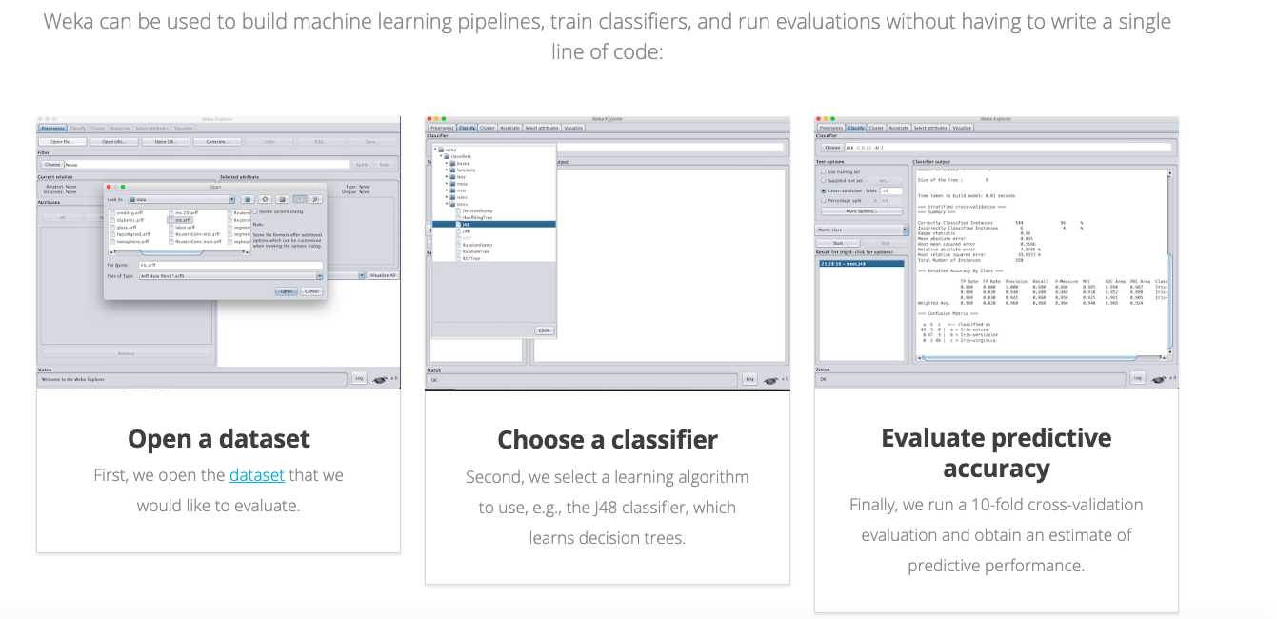
Software Used
Steps for using weka
1.)Select a stock’s data set found from web
2.)Then choose a Classifier(Learning Algo)
3.)With the help of this data it will use
Machine Learning Algorithm inorder to
find the predictive accuracy

Slide 5
Some Basic terms
Linear regression: linear regression is a linear approach to modelling the relationship between a scalar response and one more explanatory variables.
Simple linear regression: In statistics, linear simple regression is a linear regression model with a single explanatory variable.
Multilayer perceptron: A multilayer perceptron is a feedforward artificial neural network that generates a set of outputs from a set of inputs.
Gaussian processes: A Gaussian process is a stochastic process (a collection of random variables indexed by time or space), such that every finite collection of those random variables has a multivariate normal distribution i.e. every finite linear combination of them is normally distributed.
Additive regression: Additive regression is a nonparametric regression method. It uses a one-dimensional smoother to build a restricted class of nonparametric regression models. It is more flexible than a standard linear model, while being more interpretable than a general regression surface at cost of approximation errors.
Bagging: Is a machine learning ensemble meta-algorithm designed to improve the stability and accuracy of machine learning algorithms used in statistical classification and regression.
Random sub space: Random sub space also called attribute bagging or feature bagging, is an ensemble learning method that attempts to reduce the correlation between estimators in an ensemble by training them on random samples of features instead of entire feature set.
Randomizable filtered classifier: In using randomizable filter as an ensemble base classifier, each base classifier is built using a different random number seed (but based on the same data) .
Stacking: stacking is an ensemble learning technique that combines multiple classification or regression models via a Meta classifier or Meta regressor.
Vote: voting is the simplest way of combining the predictions from multiple machine learning algorithms. Voting classifier isn’t a actual classifier but a wrapper for a set of different ones that are trained and valuated in parallel in order to exploit the different peculiarities of each algorithm.

Slide 6
Slide Title
What makes this project relevant
Ability to predict direction of stock/index price accurately is crucial for market dealers or investors to maximize their profits.
Web is full of textual information resources but one can use this abundant textual information to get datasets of various companies.

Slide 7
Slide Title
What is the ultimate goal of this project
Inorder to propose a novel method for the prediction of stock market closing price with the least possible error

Slide 8
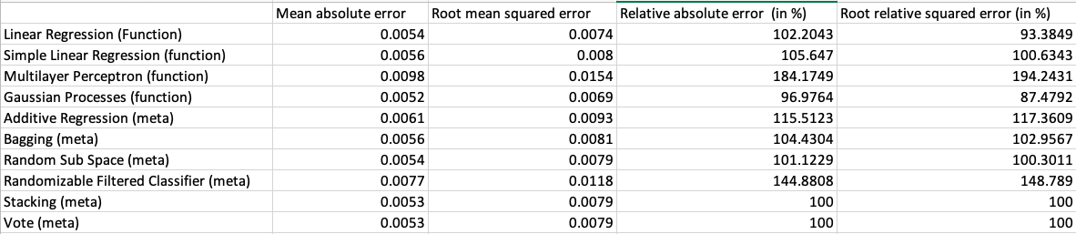
Our Calculations

Slide 13
Bibliography
www.yahoo.finance.com
www.stockwatch.in
Financial Times (www.ft.com) maintain excellent electronic versions of their daily
issues.
Reuters(www.investools.com)

